Slide 1

COVID-19 CLINICAL TRIAL PROJECT 1
GROUP MEMBERS:
Mohamed Aziz, Pamela Schau
Mario Shields, Qian Sun, Abel Rodriguez

Slide 2
Focus: COVID-19 CLINICAL TRIALS Source of Data: ClinicalTrials.gov (a resource provided by the U.S. National Library of Medicine) Questions/Ideas: *the average length of trials *studies based on the 4 phases *Enrollment & Trials Based on Geographics *the TENDIENCES OF ENROLLED PARTICIPANTS THAT SHOW RESULTS VS. NO RESULTS *The Count of successful clinical trials based on drugs & p-values Visualizations: Bar graph, pie chart, Box Plot

Slide 3
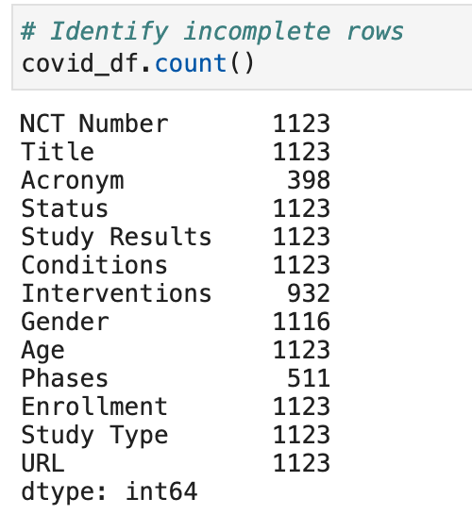
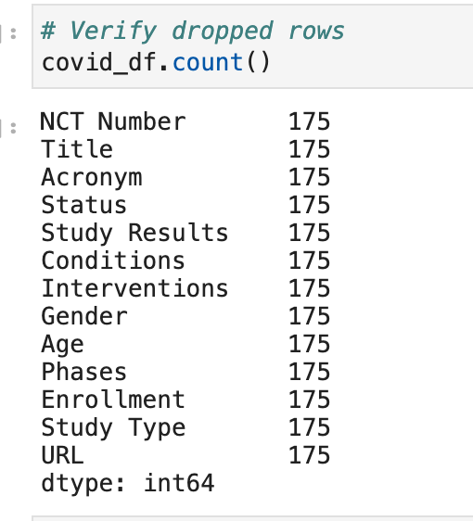
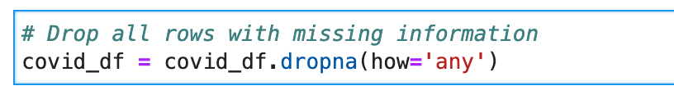
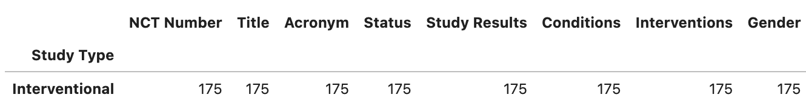
MISSING DATA observational trials

Slide 4
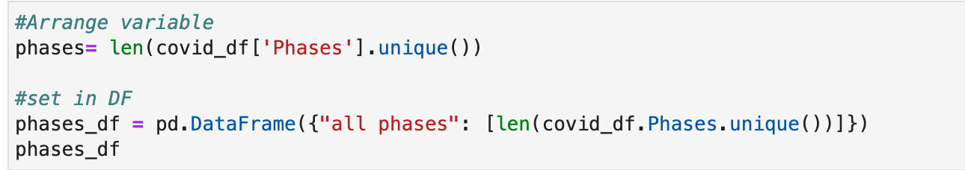
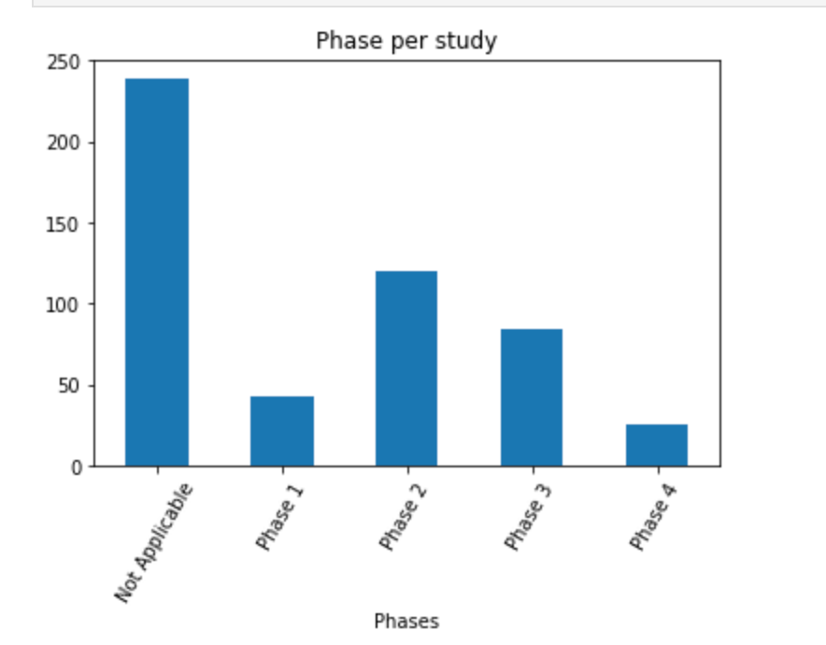
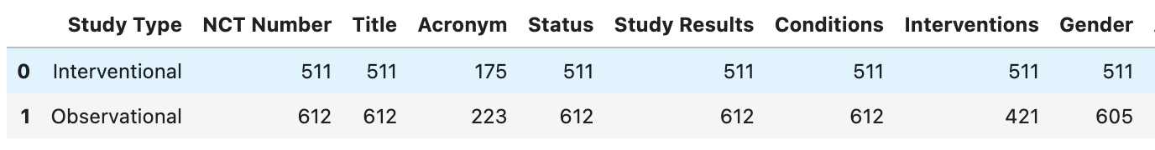
Data Findings: More observational studies were conducted then interventional according to dataset

